Slide 1


SailorAid
Progression Presentation 2
Monday week 37
Presenters:
Kenny Eriksson, Hardware designer
Henrik Theolin, Software designer

Slide 2

Project
Make system with sensors to get information
Help sailor make good decisions

Slide 3
Progression
Power supply - Elias Grape
GPS - Daniel Brolin
IMU Circuit - Kenny Eriksson
Calculating velocity and position - Oskar Axelsson
Pressure measurement - Josef Lundberg
Connection - Johannes Sjölund
Feedback - Henrik Theolin

Slide 4
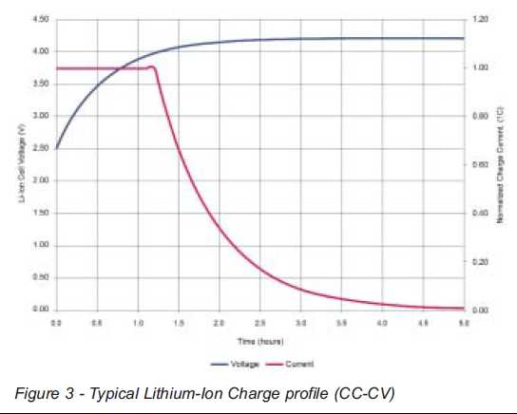
Power supply
Battery management system
Important decisions BMS make
Rate of charge
Life of the batteries
Overall efficiency
CC/CV (constant current, constant voltage)

Slide 5
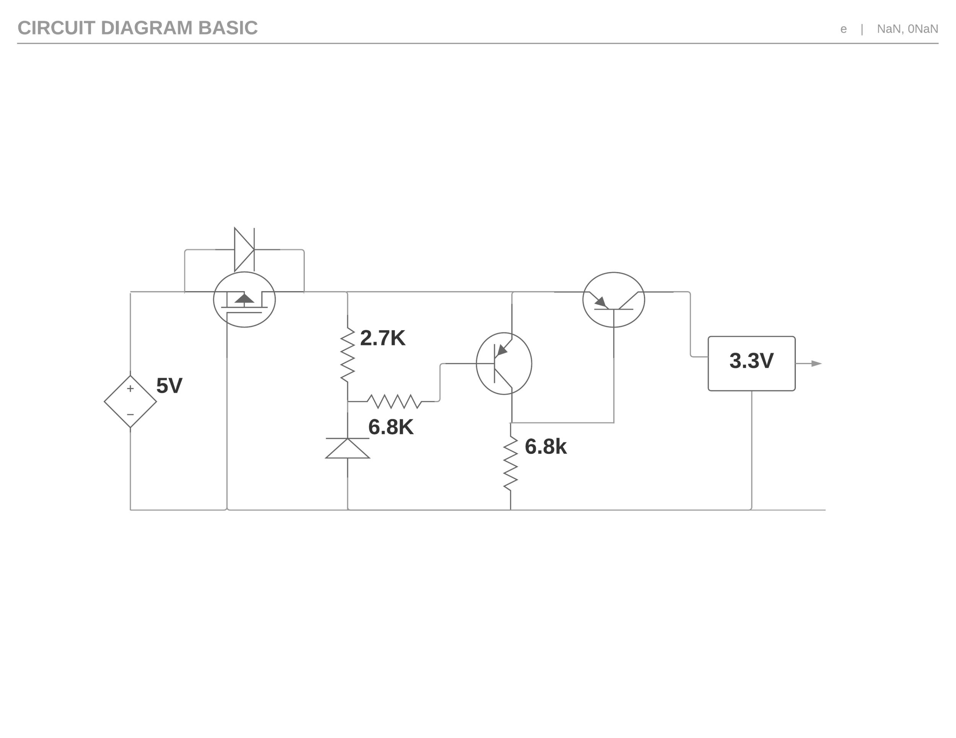
Over voltage protection circuit
Reverse voltage protection
Voltage regulation
Notes:
Over voltage protection circuit with reverse voltage protection and voltage regulation. All transistors are PNPs, top left is a PMOS and the others are P-cannel BJTs. Maxim integrated. (n.d.). Overvoltage Protection in Automotive Systems
. Retrieved from https://www.maximintegrated.com/en/app-notes/index.mvp/id/760

Slide 6
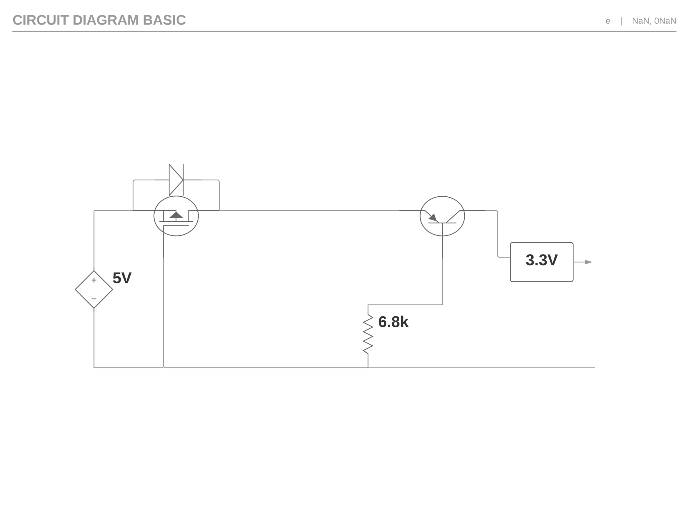
Normal operating conditions
Top left and right transistors are conducting
Notes:
During normal operating conditions this is what the effective circuit looks like. Top left and top right transistors are conducting as zero volts are applied to their respective gate and base. While the transistor in the middle is not, as a voltage is applied to the base. The diode is a Zener diode with a voltage drop of 5.6V. When the voltage is lower then that it acts as a open circuit.

Slide 7

Reverse voltage protection
PMOS transistor gets voltage at gate and stop conducting
Notes:
If the voltage would be reversed, a voltage would be applied to the gate of the PMOS and it would stop conducting. Thus removing any voltage to the circuit.

Slide 8
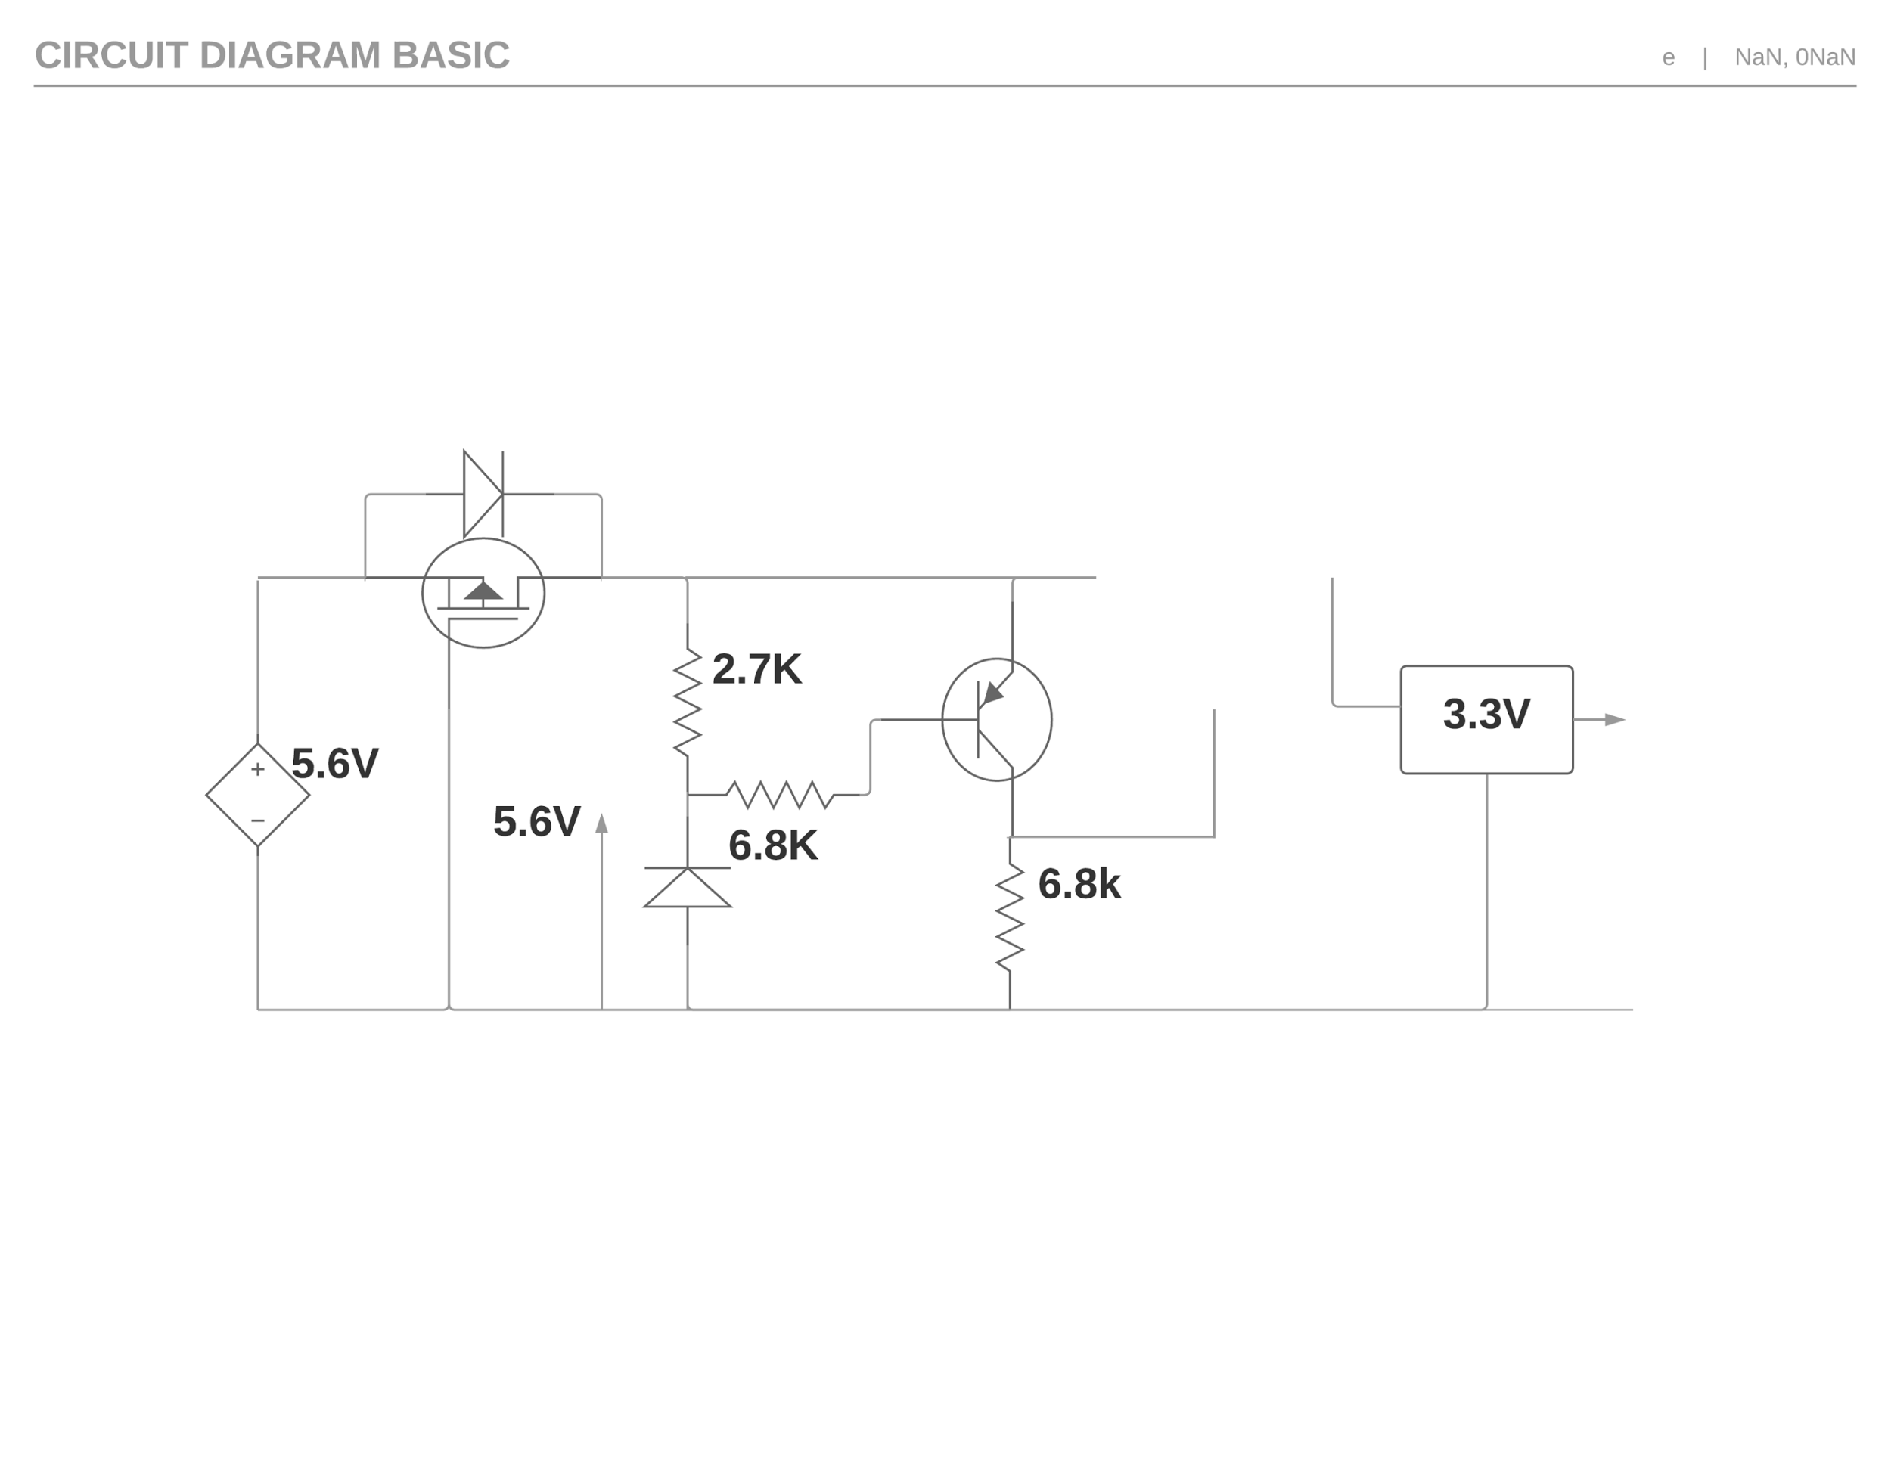
Over voltage protection
Voltage above 5.6V, no current can flow
Notes:
If the voltage at the input would rise to or above 5.6V, the Zener diode starts conducting and a current can start to flow from the emitter to the base of the middle transistor. Making the voltage the same on both the emitter and base of the top right transistor. So no current can flow from emitter to base resulting in a circuit break that protects the circuit.

Slide 9
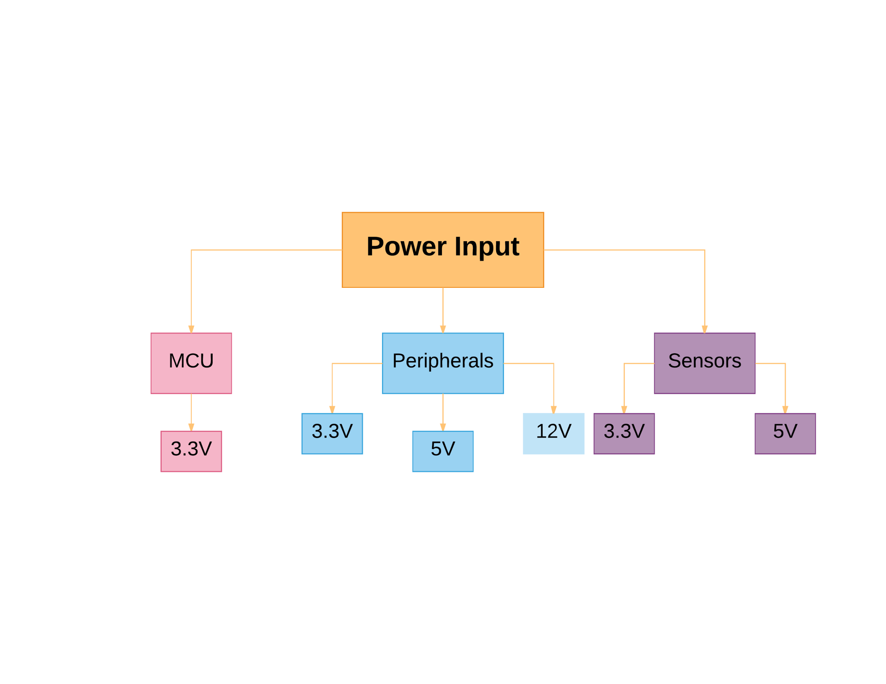
Power input
Power available to the system
Notes:
Flow chart for voltage requirements in the circuit. Some Peripherals use 12V, we will most likely not use any of those. So we will not implement it.

Slide 10
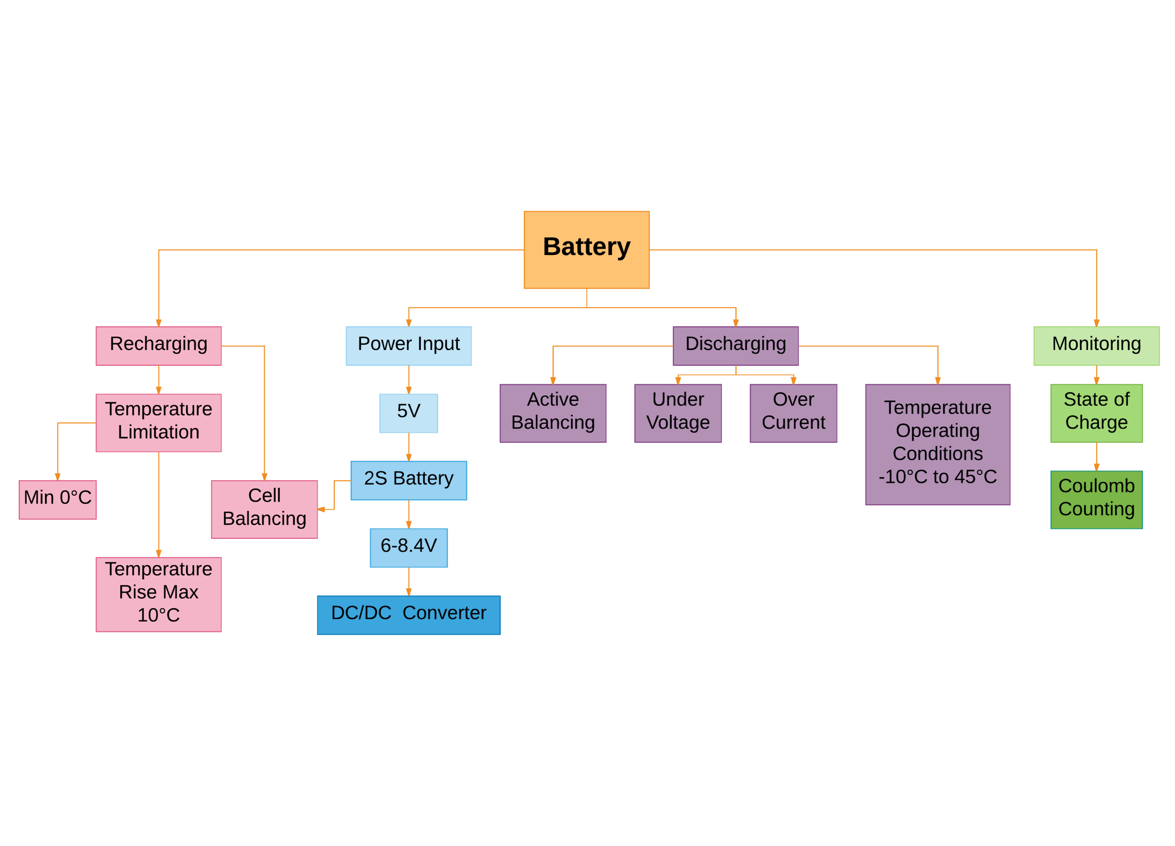
Battery
2 cell battery-pack
DC/DC converter is needed
Recharging
Discharge faults
Monitoring battery state of charge
Notes:
As concluded earlier maximum 5V is needed therefor 2 batteries in series are needed. A 2S battery-pack will range between 8.4V fully charged and 6V fully discharged. A DC/DC converter is therefor needed.
Recharging batteries has to occur under certain temperature conditions. Charging below 0°C causes lithium plating on the cobalt electrodes. If the temperature rises more than 10°C the battery will take damage and its capacity will be reduced. Cell balancing during charge to ensure both batteries are at the same state of charge. Weicker, P. (2014). A Systems Approach to Lithium-ion Battery Management. Boston: Artech House.
During discharge four faults may occur. Active balancing ensures that one or more batteries in a pack is not depleted before the others. Detecting and acting on under voltage and over current to protect the battery from operating outside of its capabilities.
By monitoring the batteries state of charge (battery %) the user will know how much longer the product will function before the next recharge. "The simplest approach to state of charge computation is coulomb counting, or amp-hour integration. Simply put, the battery current, divided by the battery capacity, is equal to the rate of change in SOC." -Weicker, P. (2014). A Systems Approach to Lithium-ion Battery Management. Boston: Artech House.

Slide 11
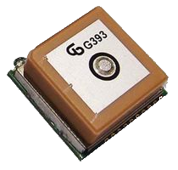
GPS A2235-H
1 Hz updating frequency
High sensitivity
48 tracking channels
Operates in 3V3 environment
Low current in resting mode (50-500μA)
A2235 GPS Module
Notes:
As concluded earlier maximum 5V is needed therefor 2 batteries in series are needed. A 2S battery-pack will range between 8.4V fully charged and 6V fully discharged. A DC/DC converter is therefor needed.
Recharging batteries has to occur under certain temperature conditions. Charging below 0°C causes lithium plating on the cobalt electrodes. If the temperature rises more than 10°C the battery will take damage and its capacity will be reduced. Cell balancing during charge to ensure both batteries are at the same state of charge. Weicker, P. (2014). A Systems Approach to Lithium-ion Battery Management. Boston: Artech House.
During discharge four faults may occur. Active balancing ensures that one or more batteries in a pack is not depleted before the others. Detecting and acting on under voltage and over current to protect the battery from operating outside of its capabilities.
By monitoring the batteries state of charge (battery %) the user will know how much longer the product will function before the next recharge. "The simplest approach to state of charge computation is coulomb counting, or amp-hour integration. Simply put, the battery current, divided by the battery capacity, is equal to the rate of change in SOC." -Weicker, P. (2014). A Systems Approach to Lithium-ion Battery Management. Boston: Artech House.

Slide 12
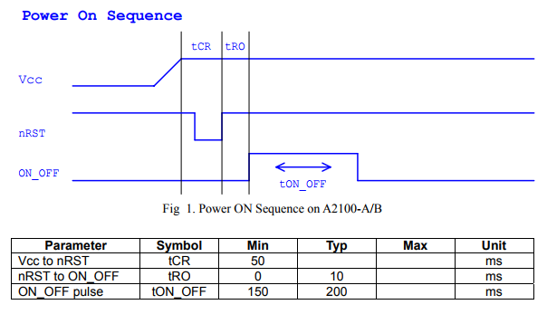
GPS A2235-H
Requirements:
Steady voltages
Protection from sudden loss off power
Proper startup and shutdown sequences
UART^{[1]}, SPI or I²C connection, we went for UART.
From Proper power ON/OFF sequence datasheet
using maestro GPS recievers
^{[1]}Universal asynchronous receiver-transmitter
Notes:
As concluded earlier maximum 5V is needed therefor 2 batteries in series are needed. A 2S battery-pack will range between 8.4V fully charged and 6V fully discharged. A DC/DC converter is therefor needed.
Recharging batteries has to occur under certain temperature conditions. Charging below 0°C causes lithium plating on the cobalt electrodes. If the temperature rises more than 10°C the battery will take damage and its capacity will be reduced. Cell balancing during charge to ensure both batteries are at the same state of charge. Weicker, P. (2014). A Systems Approach to Lithium-ion Battery Management. Boston: Artech House.
During discharge four faults may occur. Active balancing ensures that one or more batteries in a pack is not depleted before the others. Detecting and acting on under voltage and over current to protect the battery from operating outside of its capabilities.
By monitoring the batteries state of charge (battery %) the user will know how much longer the product will function before the next recharge. "The simplest approach to state of charge computation is coulomb counting, or amp-hour integration. Simply put, the battery current, divided by the battery capacity, is equal to the rate of change in SOC." -Weicker, P. (2014). A Systems Approach to Lithium-ion Battery Management. Boston: Artech House.

Slide 13
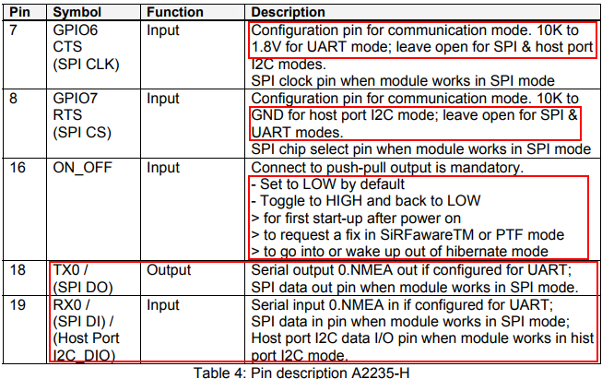
GPS A2235-H
Settings and UART connection
UART:
Low update speed, perfect for 1Hz GPS
Low power consumption
Only two wires
For PSSS^{[1]}, high speed digital logic is needed on ON_OFF pin
Pin description for connection and ON-OFF settings
^{[1]}Proper Startup Shutdown Sequence
Notes:
As concluded earlier maximum 5V is needed therefor 2 batteries in series are needed. A 2S battery-pack will range between 8.4V fully charged and 6V fully discharged. A DC/DC converter is therefor needed.
Recharging batteries has to occur under certain temperature conditions. Charging below 0°C causes lithium plating on the cobalt electrodes. If the temperature rises more than 10°C the battery will take damage and its capacity will be reduced. Cell balancing during charge to ensure both batteries are at the same state of charge. Weicker, P. (2014). A Systems Approach to Lithium-ion Battery Management. Boston: Artech House.
During discharge four faults may occur. Active balancing ensures that one or more batteries in a pack is not depleted before the others. Detecting and acting on under voltage and over current to protect the battery from operating outside of its capabilities.
By monitoring the batteries state of charge (battery %) the user will know how much longer the product will function before the next recharge. "The simplest approach to state of charge computation is coulomb counting, or amp-hour integration. Simply put, the battery current, divided by the battery capacity, is equal to the rate of change in SOC." -Weicker, P. (2014). A Systems Approach to Lithium-ion Battery Management. Boston: Artech House.

Slide 14
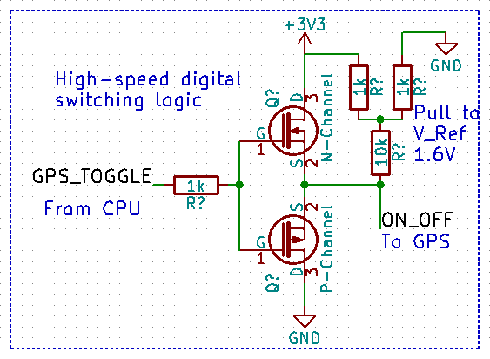
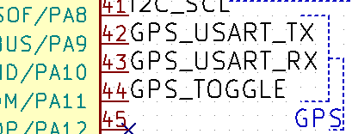
GPS A2235-H
wiring
GPS_TOGGLE
Controls ON_OFF sequence
Sequence can be steady controlled using two switching depletion mode MOSFETS
USART Transmit
USART Receive
High speed switching logic
All wires from CPU to GPS
Notes:
As concluded earlier maximum 5V is needed therefor 2 batteries in series are needed. A 2S battery-pack will range between 8.4V fully charged and 6V fully discharged. A DC/DC converter is therefor needed.
Recharging batteries has to occur under certain temperature conditions. Charging below 0°C causes lithium plating on the cobalt electrodes. If the temperature rises more than 10°C the battery will take damage and its capacity will be reduced. Cell balancing during charge to ensure both batteries are at the same state of charge. Weicker, P. (2014). A Systems Approach to Lithium-ion Battery Management. Boston: Artech House.
During discharge four faults may occur. Active balancing ensures that one or more batteries in a pack is not depleted before the others. Detecting and acting on under voltage and over current to protect the battery from operating outside of its capabilities.
By monitoring the batteries state of charge (battery %) the user will know how much longer the product will function before the next recharge. "The simplest approach to state of charge computation is coulomb counting, or amp-hour integration. Simply put, the battery current, divided by the battery capacity, is equal to the rate of change in SOC." -Weicker, P. (2014). A Systems Approach to Lithium-ion Battery Management. Boston: Artech House.

Slide 15
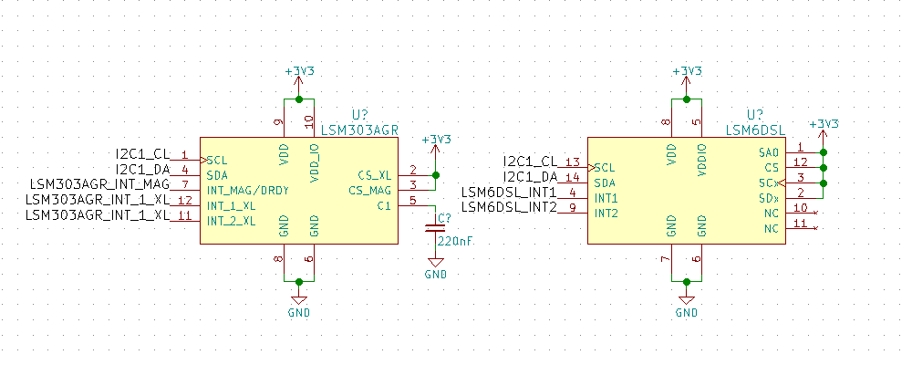
Inertial measurement unit (IMU)-Circuit
Used together with the Madgwick-algorithm for precise calculation of instantaneous inclination
Data from the IMU circuit can also be used for more accurate positioning and velocity

Slide 16
CubeMX code prototype
The goal this week is to implement a data logging prototype with CubeMX-generated code and standard HAL libraries

Slide 17
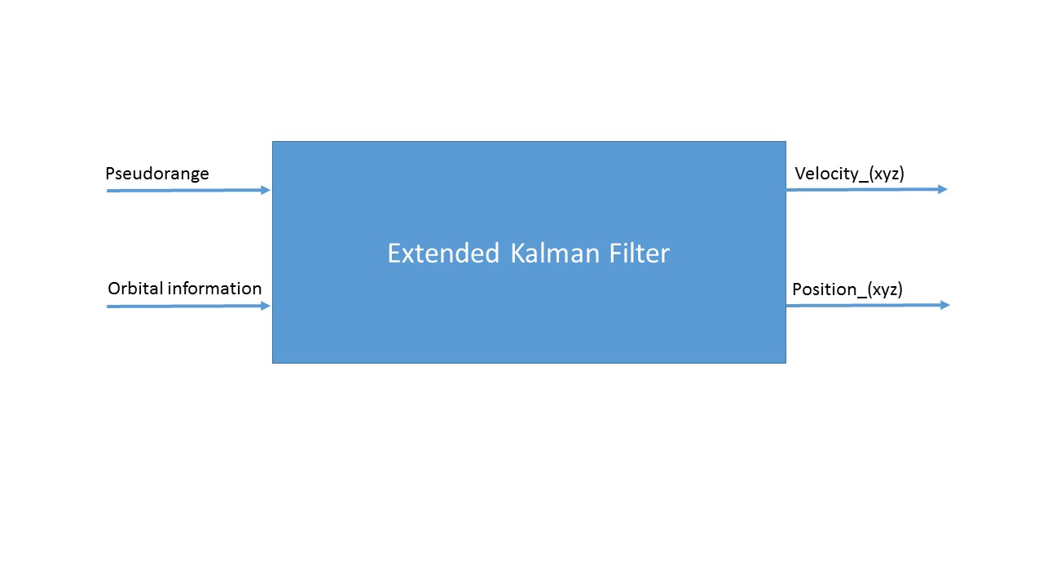
Calculating velocity and position
Kalman filter fusion
Notes:
Using the GPS when determining the position of the user will result in nonlinear equations, hence the Extended Kalman Filter has to be applied. Since the GPS will use four satellites we will get four different nonlinear equations to solve. Solving them will then provide the states that we are looking for

Slide 18
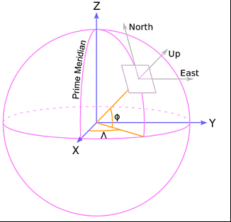
Coordinate system
Distance between satellite and user
Notes:
Where the Pseudorange is the distance between the satellite and the user, The position in the input are cartesian coordinates from the satellite.
The figure above shows that the coordinate system [north, east, up] are slaved to [X, Y, Z], the satellites uses the [X, Y, Z] and the user uses [north, east, up].
Some fundamental physics to solve positioning and velocity.
P_new=P_old + dt*V_old
V_new=V_new
The above equations are the only we need to solve our position and velocity problem in the three different direction, hence the state matrix will be

Slide 19
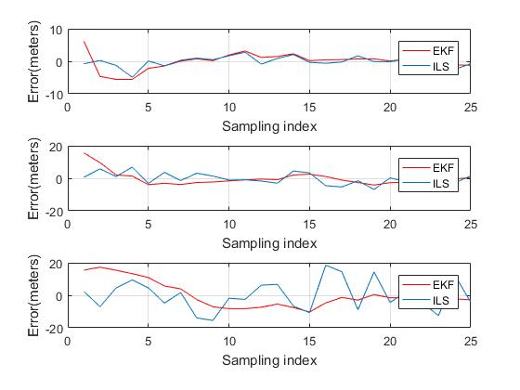
Coordinate system
EKF Vs. LS
Notes:
The figure above shows the position in mean square error in x,y ,z direction, respectively when the velocity is constant.

Slide 20
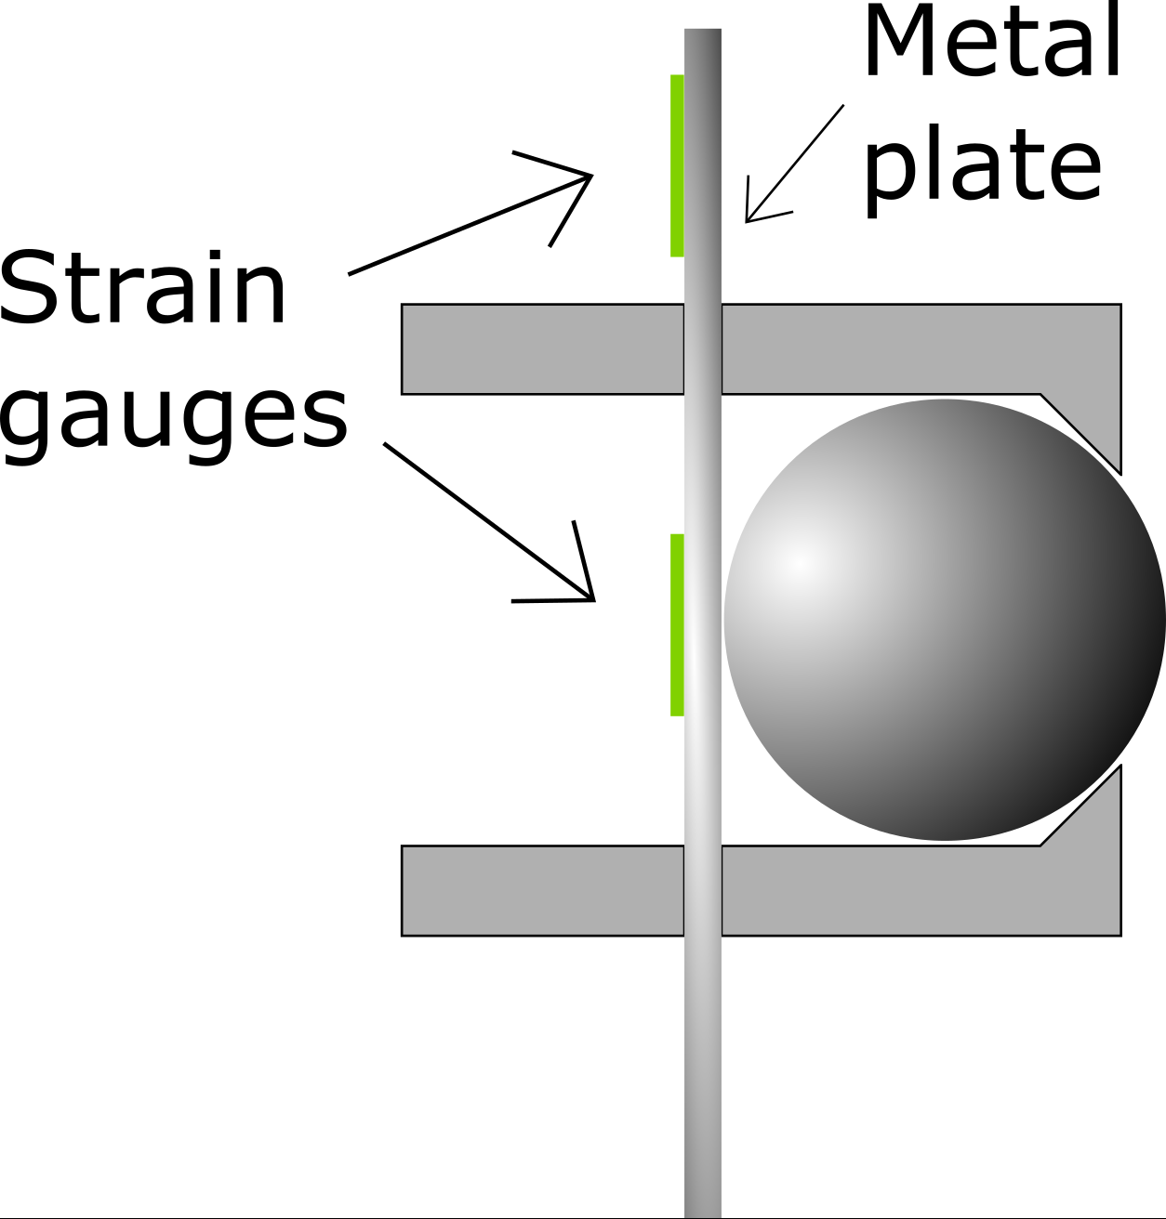
Pressure measurement
Force on the center board
Mounted safely
Waterproof
No modifications on the centerboard
Notes:
One of the measurements that is needed is the force exerted at the centerboard. The goal is to get a reading of how much forces there is on the board and to measure this properly we have taken the approach of implementing strain gauges. Some research according strain gauges has been done during the week.
The implementation:
By looking at some different solutions there is not any other solutions that we found that might be as clean looking and prominent/promising as this approach. The solutions that required the sensors to be mounted on the outside or in parts that would be in danger if a crash might occur was scratched. Every solution is mandatory to be waterproof and sealed properly from the harsh environment that this system has as its home turf. Which makes our approach a great solution.
The board itself will not be disassembled in any major part of way. Meaning that our approach doesn’t need any modifications to the board itself. This has been our goal and the approach we choose to go. Modifications in the mounting plate is the way to go, the other solutions we thought about is either way more difficult to apply and mount or more complex.
The prototype:
To implement the gauges, we have made a prototype to show how the measurements will be made. The prototype is a bit bigger than the intended solution for this project but it's good to see how it would be constructed. The function is easy to understand. The board goes on the outside and can easily slide up and down past this ball. The ball itself is kept inside this small area where it can move in and out. The force is then measured at the back where there will be a plate. The deflection of this plate which will be the origin to the strain will be measured through strain gauges.
The gauge itself will measure a small difference in resistance. This small difference is most likely going to be difficult to measure without any amplifying circuit connected. With a such small signal the system might have issues with noise. Another problem is that the signal might drift, and therefore make different measurements as the circuit is running. And finally, with the signal getting amplified with a big amount the result may be off by a large amount.
This way of implementing strain gauges were our first idea.
The main case for this strategy was that in the start of this project these gauges were supplied to us, as a leftover from the last group. With this implementation, we could already start working on a prototype and get a small head start in the project. But as some research shows, it is a more difficult way to solve this problem and it would take bit more work and some sensitive circuits to measure the force. The gauges also need to be stuck in place using some specific glue and can easily be done incorrectly and therefore prevent good measurements.

Slide 21
Measuring
Small difference in resistance
Needs amplifying
Noise
Drift
Notes:
One of the measurements that is needed is the force exerted at the centerboard. The goal is to get a reading of how much forces there is on the board and to measure this properly we have taken the approach of implementing strain gauges. Some research according strain gauges has been done during the week.
The implementation:
By looking at some different solutions there is not any other solutions that we found that might be as clean looking and prominent/promising as this approach. The solutions that required the sensors to be mounted on the outside or in parts that would be in danger if a crash might occur was scratched. Every solution is mandatory to be waterproof and sealed properly from the harsh environment that this system has as its home turf. Which makes our approach a great solution.
The board itself will not be disassembled in any major part of way. Meaning that our approach doesn’t need any modifications to the board itself. This has been our goal and the approach we choose to go. Modifications in the mounting plate is the way to go, the other solutions we thought about is either way more difficult to apply and mount or more complex.
The prototype:
To implement the gauges, we have made a prototype to show how the measurements will be made. The prototype is a bit bigger than the intended solution for this project but it's good to see how it would be constructed. The function is easy to understand. The board goes on the outside and can easily slide up and down past this ball. The ball itself is kept inside this small area where it can move in and out. The force is then measured at the back where there will be a plate. The deflection of this plate which will be the origin to the strain will be measured through strain gauges.
The gauge itself will measure a small difference in resistance. This small difference is most likely going to be difficult to measure without any amplifying circuit connected. With a such small signal the system might have issues with noise. Another problem is that the signal might drift, and therefore make different measurements as the circuit is running. And finally, with the signal getting amplified with a big amount the result may be off by a large amount.
This way of implementing strain gauges were our first idea.
The main case for this strategy was that in the start of this project these gauges were supplied to us, as a leftover from the last group. With this implementation, we could already start working on a prototype and get a small head start in the project. But as some research shows, it is a more difficult way to solve this problem and it would take bit more work and some sensitive circuits to measure the force. The gauges also need to be stuck in place using some specific glue and can easily be done incorrectly and therefore prevent good measurements.

Slide 22
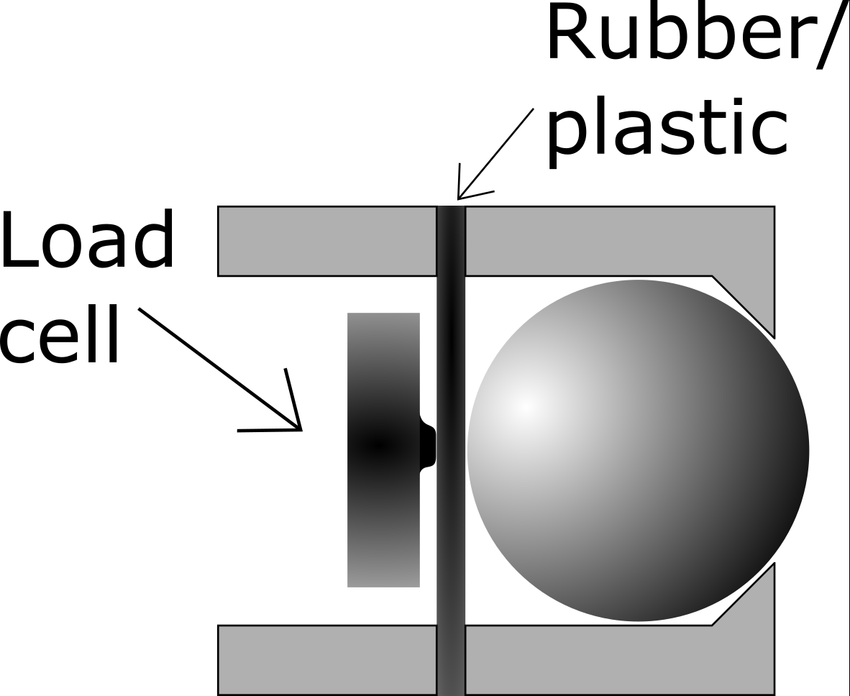
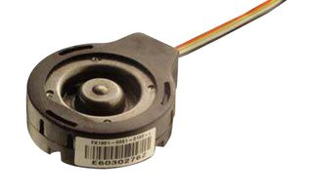
Load cells
Load cells that utilizes strain gauges
Can withstand a considerable amount of force
Notes:
New idea:
With those things considered we looked onto load cells, which is a sensor which also utilizes strain gauges to measuring forces. The difference is that the gauges are already implemented in the sensor. The difference in our prototype is instead of having a steel plate we can build it with a piece of plastic or rubber so the force is distributed to the sensor. By implementing this sensor, we will probably save time in troubleshooting. And by having a sensor unit, the modified mounting plate will be easier to produce.
Choice of component:
The force from the board onto the mounting plate will be a considerable amount. The actual force is something we don't know for sure, but that’s why we do this project. In the decision of buying the right sensor we think that a sensor with a 90.75 kg force range should be enough. In the case that we max out the sensor and overload the cell it's rated for a 150% overload without causing some damage to the sensor.
The work for this week is to build the according circuit for the sensor to work as intended. And by the time we get the sensor we will start making measurements using our prototype.

Slide 23
Connection to HMI
Data transfer from the system to feedback device made with bluetooth
X-NUCLEO-IDB04A1 Bluetooth module

Slide 24
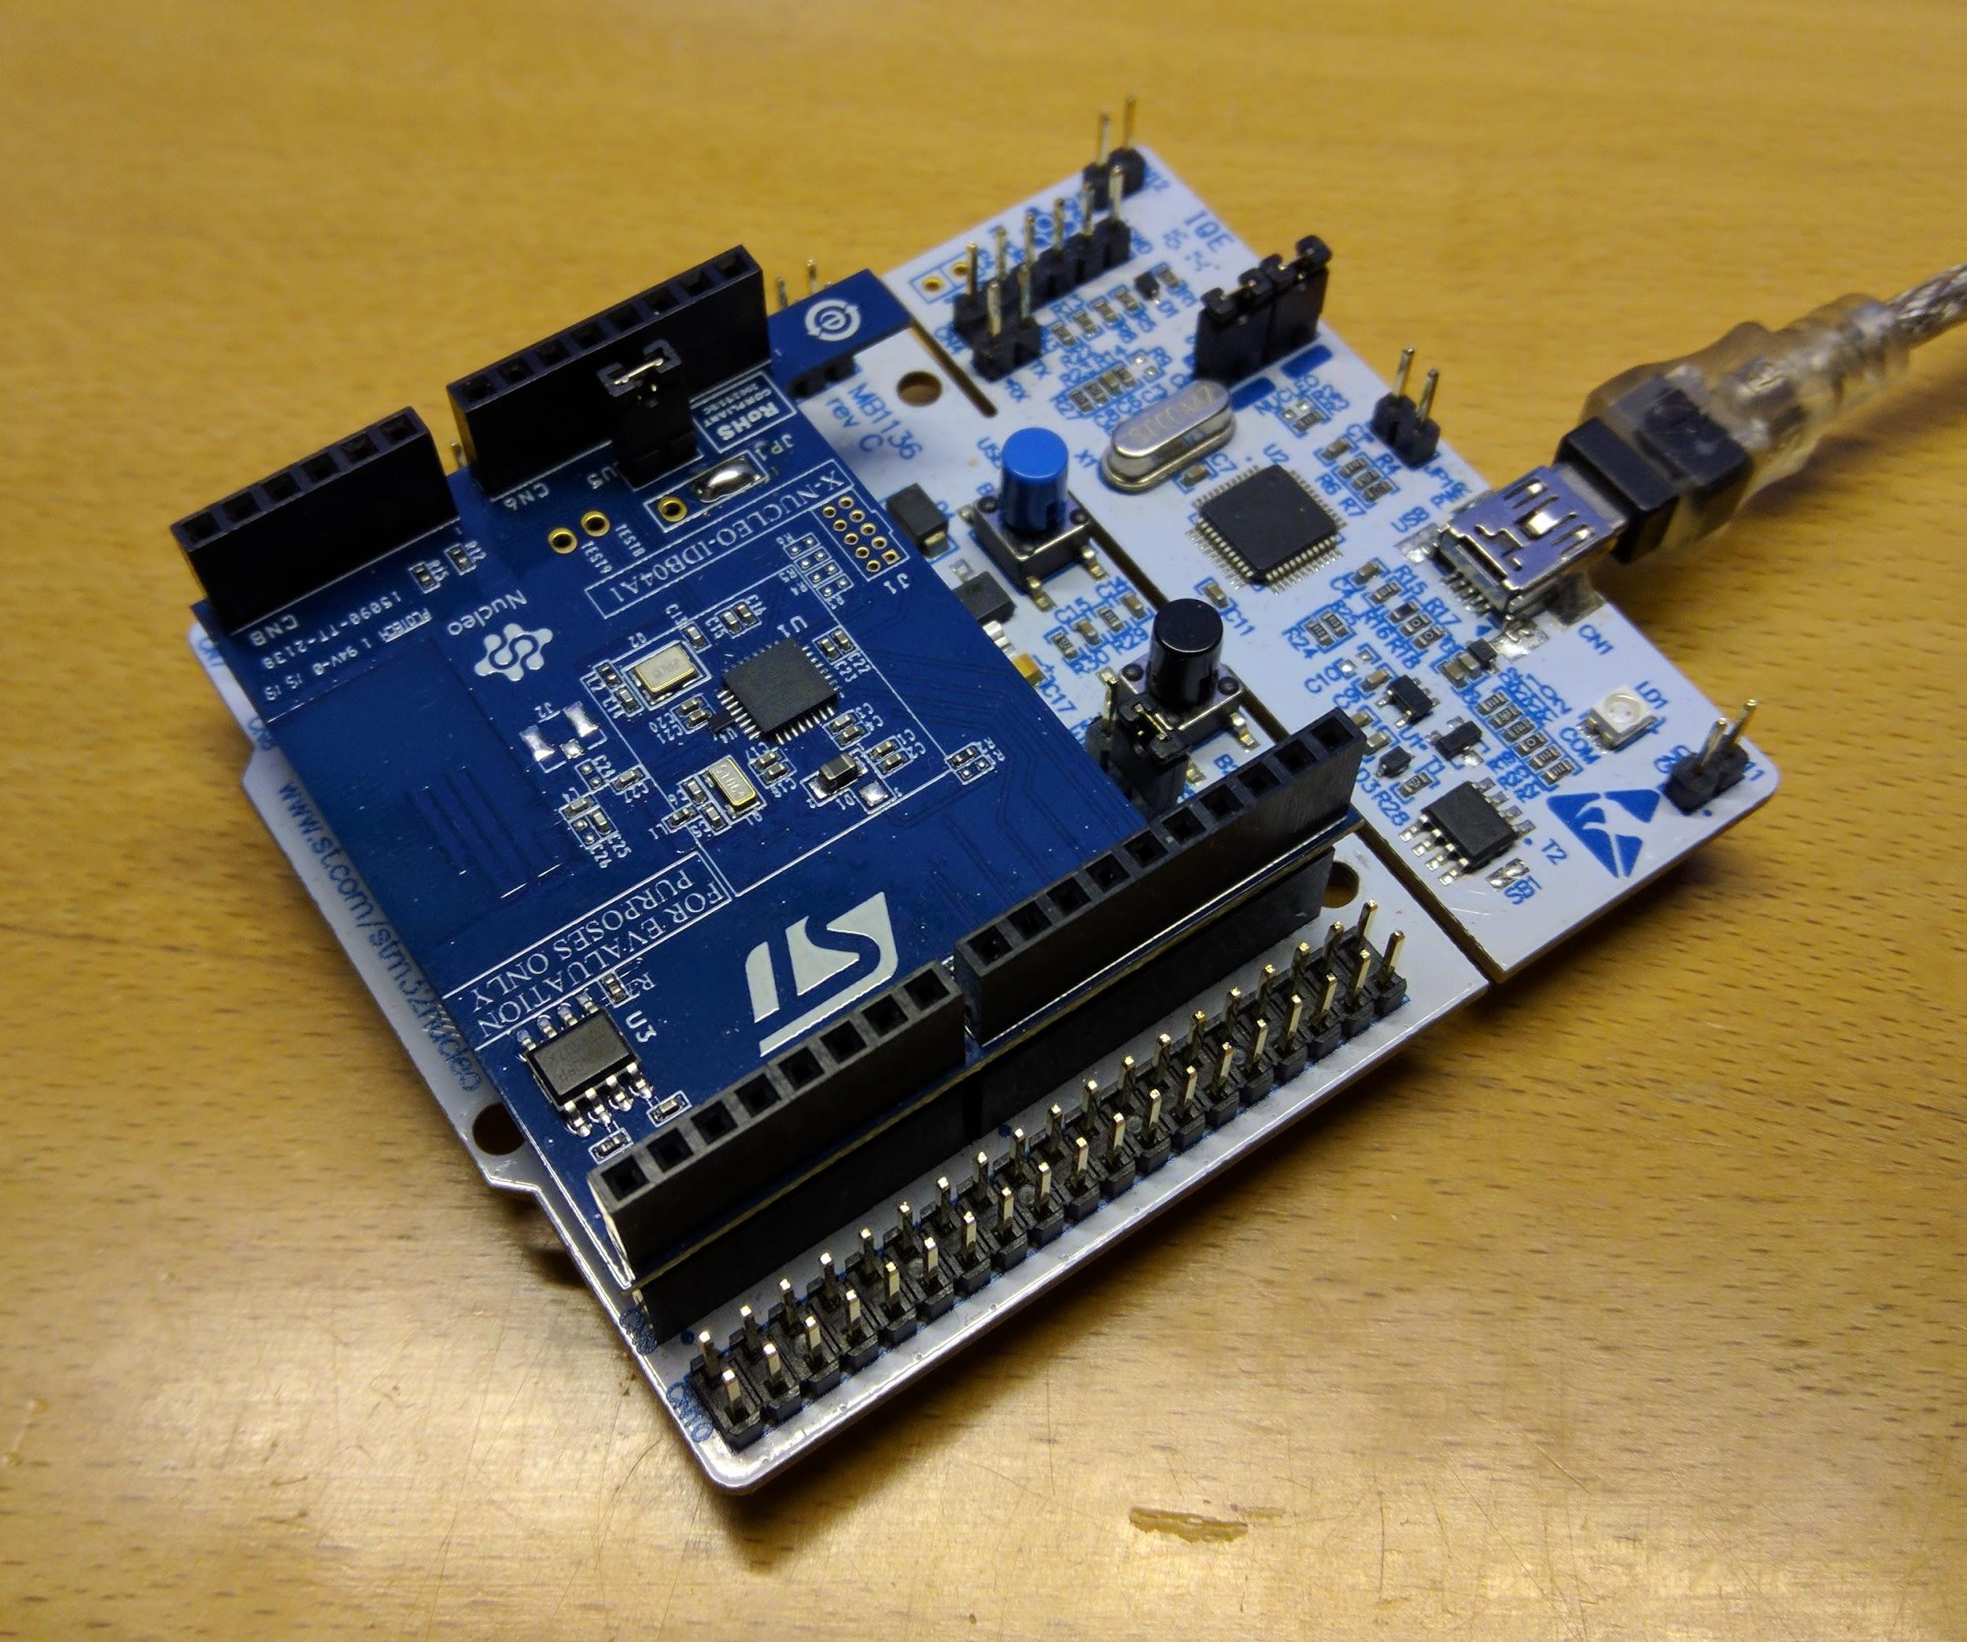
ST BlueNRG library
Low power mode
DMA transfer over SPI offloads processor usage
Very nice, but does not integrate easily with STM32CubeMX
Might have to be replaced with our own simpler library

Slide 25

Feedback
Android application
Graphical representation of data
Tilt and pressure will be easy to interpret
Choose between different feedback layouts

Slide 26
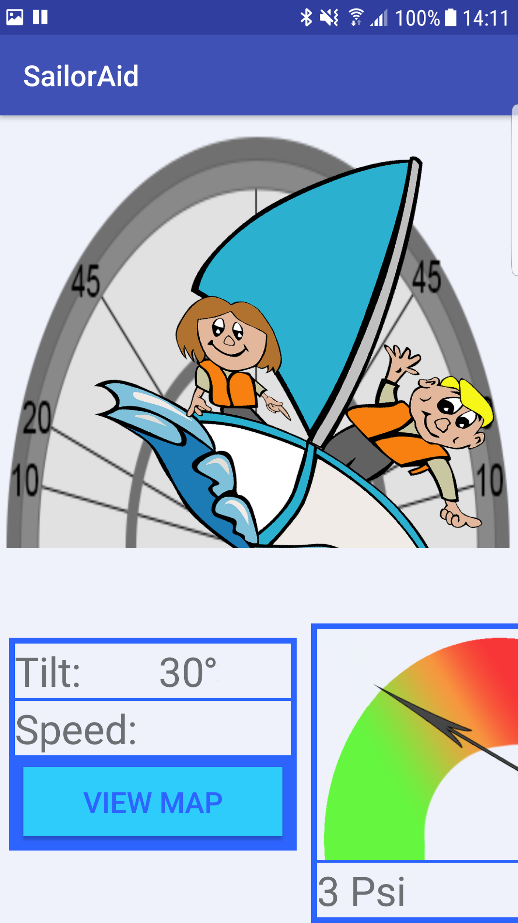
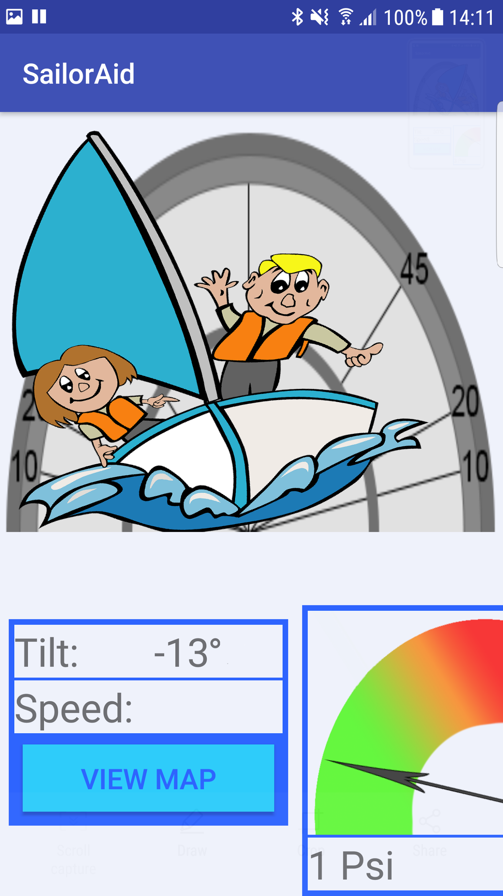
Graphical representation
Easy to identify
Included possibility to switch between layouts
Feedback with usable information to the sailor

Slide 27
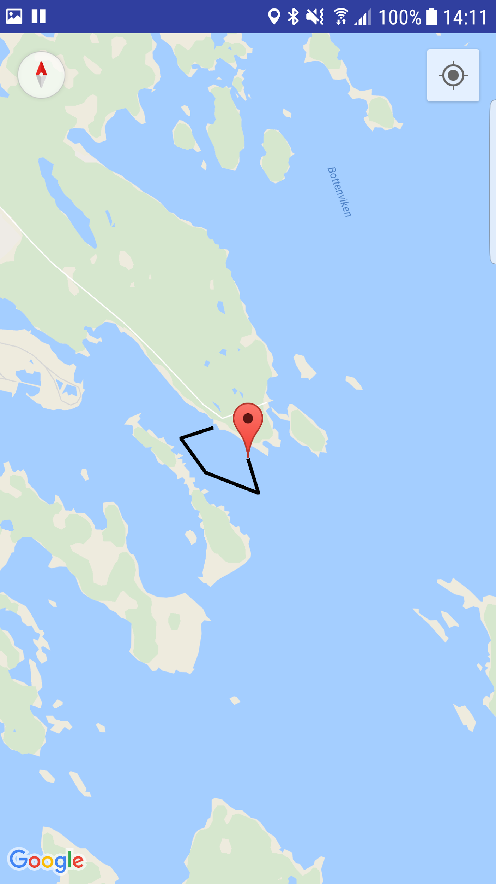
Position representation
Map with trip tracking

Slide 28
Deeper analysis
History of logged data
Logging of data
Choose between different logs
Graphs

Slide 29
What we haven’t discussed
Frequency and height of waves
Height of centerboard
Speed in water

Slide 30
References
Maxim integrated: https://www.maximintegrated.com/en/app-notes/index.mvp/id/760
Load cell: https://www.digikey.se/products/en?keywords=223-1531-ND
A2235-H: http://www.mouser.com/catalog/specsheets/EVA2235-H.pdf
GPS Sequences: http://www.mouser.com/catalog/additional/Power%20ONOFF%20Sequences%20and%20Power-On-Reset(POR)on%20A2100-AB.pdf
Kalman Filter: R G Brown, P Y C Hwang, “Introduction to random signals and applied Kalman filtering: with MATLAB exercises and solutions”, 1996.

